Slide 1
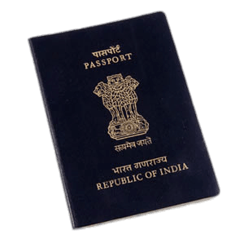


The Flight is right!
Helping consumers in India get competitive airline prices

Slide 2

background
∙ Client is Findia, a financial planning app for Indian citizens.
∙ With increased disposable income, their key demographic is increasingly relying on air travel.
∙ Findia wants to increase its ratings and market share by adding features not yet offered by competitors
Notes:
- Findia was one of the fastest growing Apple & Google Play store downloads when it launched in 2015.
- more established competitors and banks still hold the largest user share for this market, particularly with the key demographic of customers aged 18-35 years.
- Findia wants to help differentiate itself from other apps by streamlining their user experience & adding features not yet offered by competitors.

Slide 3
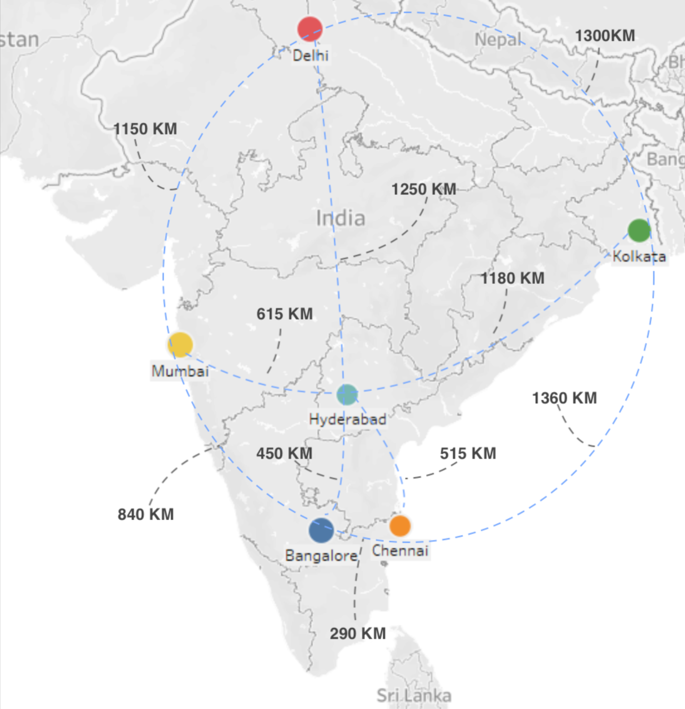
Data overview
∙ Used Kaggle dataset that scraped the “Ease my Trip” flight booking website.
∙ About 17,000 unique flights represented in 300,000 data rows.
∙Collection period of 50 days (Feb 11 – March 31, 2022).
∙ The number of days until departure were captured, but not the flight dates themselves.
Notes:
6 cities, 30 unique flight combinations
Each flight had on average 17 days of data.
Direct airline distance ranges from 300 to 1300 KM

Slide 4
Initial findings
Not so plane and simple
Tickets purchased 20 days or fewer in advance are on average ₹10 – 15,000 rupees pricier than earlier purchases.
However, this aggregate hides some unique patterns & volatility in the granular data.
Sifting through complicated layers of data for our users can save them time, money, and energy.
Significant features include:
Daily price changes
Source & destination city combinations
Approximate time of arrival or departure
Trip duration & layovers
Notes:
Anomalies and c hanges can be exploited to consumers’ advantage
The aggregate average price of business tickets & economy tickets drop & roughly even out at 40 days & 30 days until departure, respectively.
Granular analysis on flight duration, number of stops, specific city-to-city travelshows that the aggregate covers a lot of “noise” that has a lot of
Helping consumers predict when the best price will be with all of these variations can add a lot of value.

Slide 5
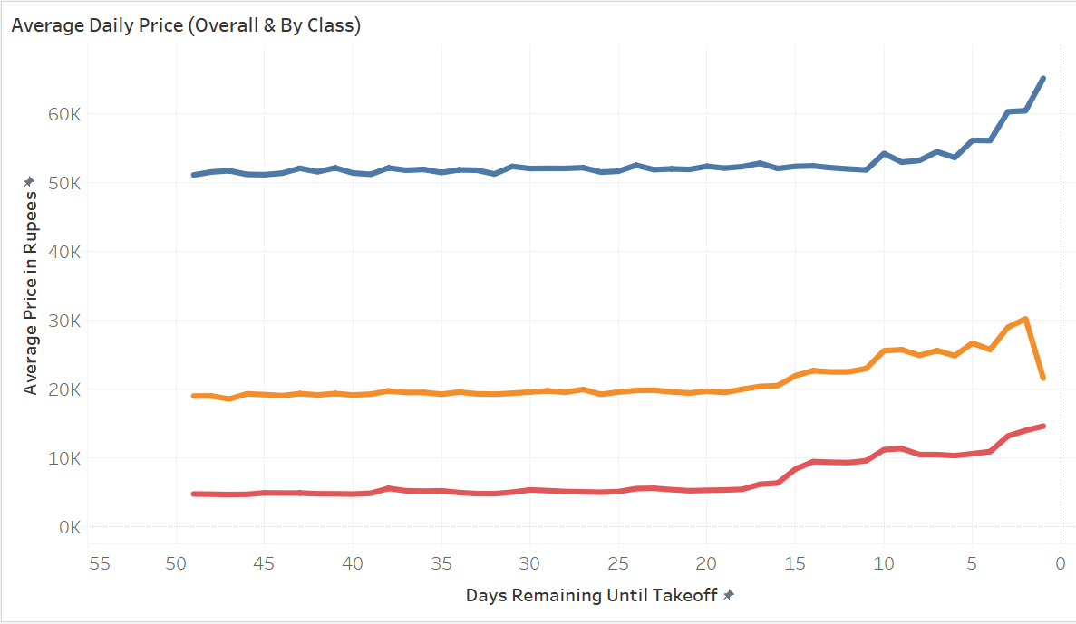

Macro view
Notes:
General best time to buy
About ₹45,000 rupee difference between business and economy tickets.
Business class’ price increase happens a little later and is a bit steeper.

Slide 6
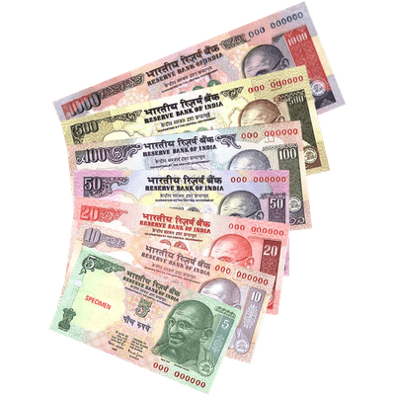
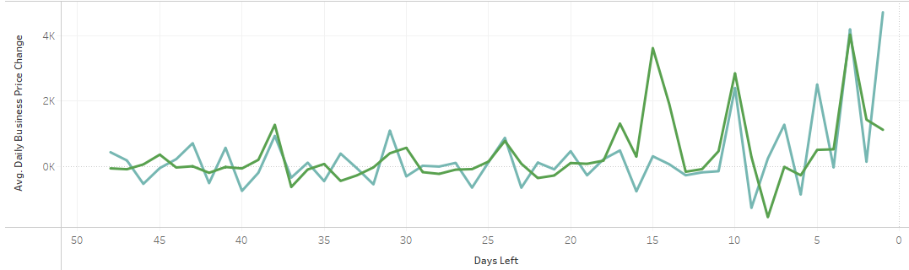

Daily volatility
Daily price differences are much more unstable.
Differences range from a few hundred to several thousand.
Business & Economy’s spikes and dips often line up.
Notes:
Advising clients to buy now or wait can potentially save them a few thousand rupees.
Lined up spikes will make creating an algorithm for this easier..

Slide 7
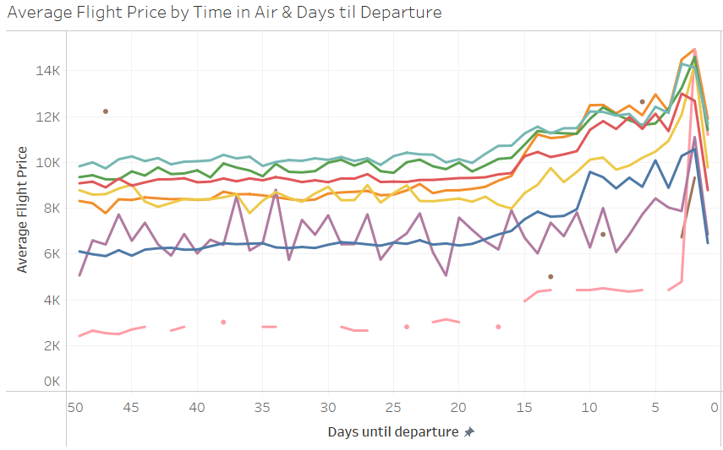
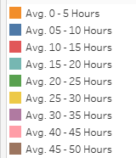
Flight duration
The 30 – 40 hour trips stood out from the rest of the data, with price changes as high as 10,000 rupees.
Notes:
Most of the flight lengths follow the same pattern as our overall averages.
Cheaper is more volatile.
Long flight doesn’t mean long distance. Air miles wold
This even includes the 45 – 50 hour segment, despite its proportionally missing data.
Duration had less of an impact than expected, except on flights between 30 – 40 hours long
The info is worth passing onto the consumer despite the low proportion of flights represented, but can still make a substantial difference for customers.
Customers could save up to 10,000 rupees by offsetting their date of purchase for these long flights.

Slide 8

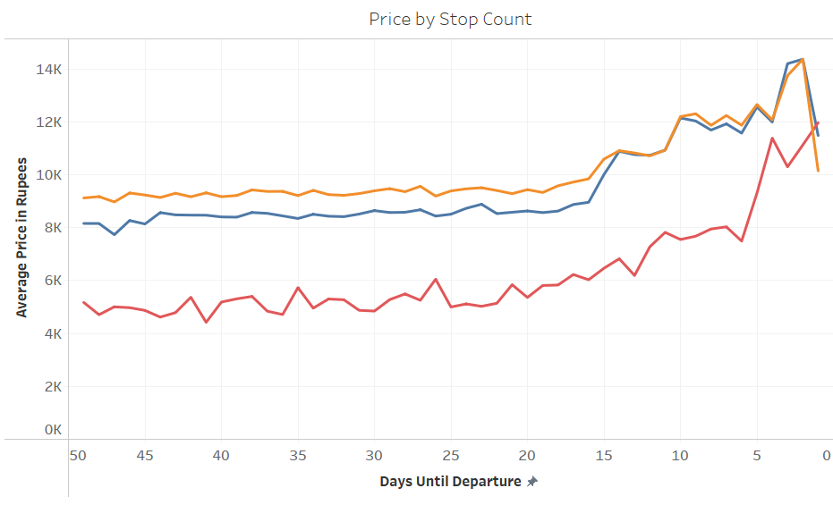
layovers
Stops, and their leads
Flights with 2 or more stops were the most volatile.
Direct and 1 stop flights had relatively smooth and almost identical price patterns.
Notes:
Intuitively, taking a flight with 2+ stops is much cheaper, UNLESS you book on departure day in which case it is usually the most expensive option.
2) Direct flights (5 hours or fewer) were almost identical to 1+ stop flights. Direct flights were cheaper, likely because of the time constraints of no-refuel flights.

Slide 9
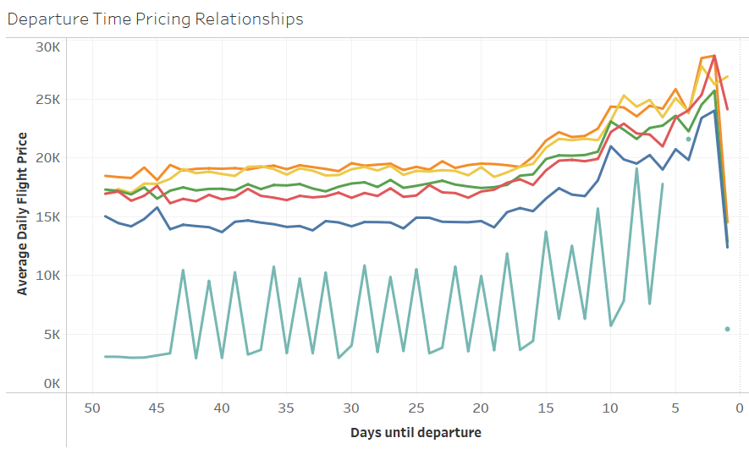
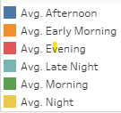
Departure time
Late night departures were cheapest, followed by afternoons.
Cheaper = more volatile.
Notes:
Afternoon appears to be the second cheapest time of day to fly, surprisingly.
During the time-based analysis (day of leaving or arrival, flight departure, number of layovers, cities) theme that cheaper items are more volatile. Price is being updated based on demand.

Slide 10
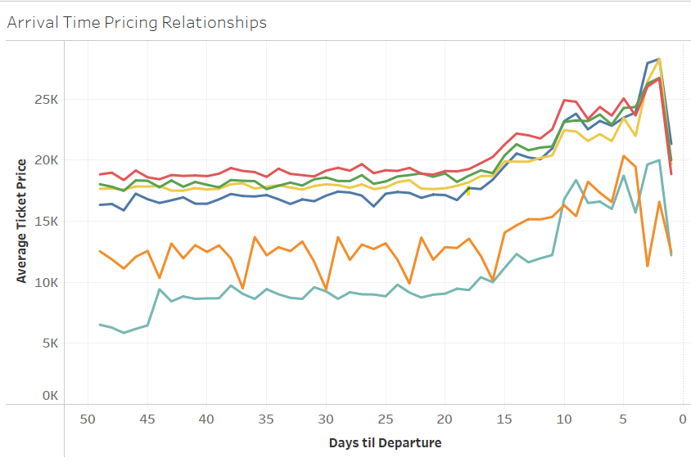
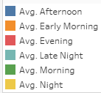
Arrival time
Early morning and late night arrivals’ were also cheap and volatile.
Notes:
Arriving extreme of late or early can save 10 – 5,000 rupees

Slide 11
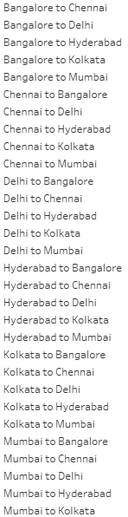
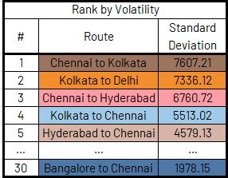
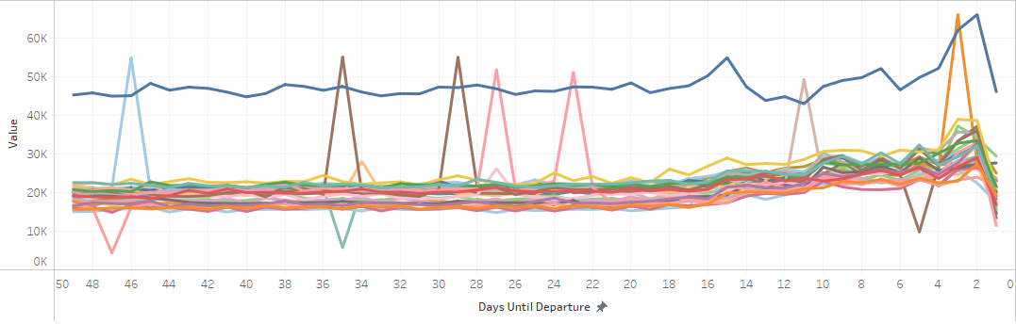
City analysis
Average prices by all source & destination city combos.
The most expensive flight travels the shortest distance!
Least volatile as well.
Chennai otherwise is associated with high variability.
Notes:
Expected longer flights to be more expensive. Indicates that airport size & scarcity is more important than distance
Bangalore to Chennai is ₹20,000 rupees more on average than all other flights. Has least amount of variability as well.
Kolkata & Hyderabad were also highon the variability combinations.
The other 5 flights involving Chennai..
were in the top 6 least stable routes for pricing. Popular tourist spot so could be useful

Slide 12
Conclusion
Customers will generally get better ticket prices if they book over 3 weeks in advance.
However, the volatility of prices during the days leading up to departure can offer significant value.
Specific cities of travel & departure/arrival time had more pricing impact than anticipated.
Cheaper items tend to be more volatile.
Stops & flight duration were impactful as well, but in a much smaller subset of flights.
further analysis
Next steps:
Exploring more features & combinations
Scraping web for dataset that:
includes date information,
extends beyond the original 50 day springtime window and
covers approximate airmiles traveled (see appendix).
Notes:
# of stops & length traveled had little impact on duration
We can predict these better with deeper research into the data and its significaincluding how they relate to travel routesdaily price volatility of daily prices aloneby daydaily price shifts are often significant and are worth more exploration, particularly those related to time of
However, the dramatic and sometimes daily price shifts (even shortly before the departure) still leave room for us to help clients plan and save money in a pinch.

Slide 13
Bonus slides
Further data analysis on non-pricing features

Slide 14
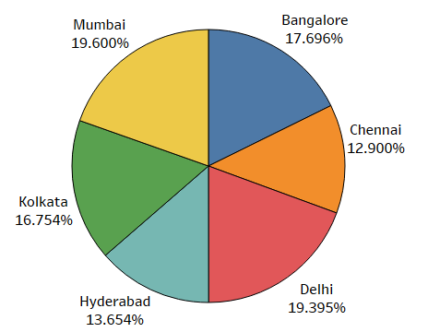
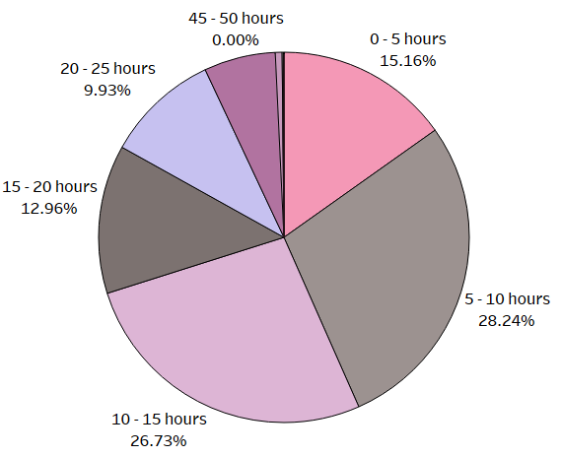
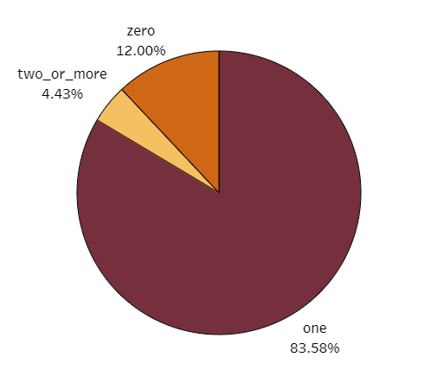
Feature relationships
Airport popularity
Flight Duration
Number of Stops
How correlated is the flight duration to the number of stops?
Notes:
Airport visitation was relatively evenly distributed, but the 3 easternmost cities (Mumbai, Delhi, and Bangalore) were the most popular, nearing almost 20%..
Over half of the flights were between 5 – 15 hours.
Vast majority had exactly one stop.

Slide 15

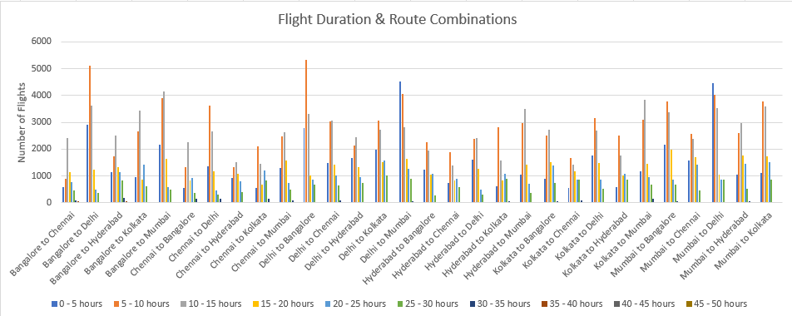
Flight Duration: impacted by distance of route?
Each inter-city path offers flights that can take anywhere from 2 – 20 hours.
∙ All flights, regardless of kilometers covered, have a left skewed normal distribution and a decent range.
Notes:
Geographical distance between cities didn’t have a ton of effect on flight length distribution.
Could benefit from knowing the airmiles traveled during each flight as opposed to approximate geographical distance.

Slide 16
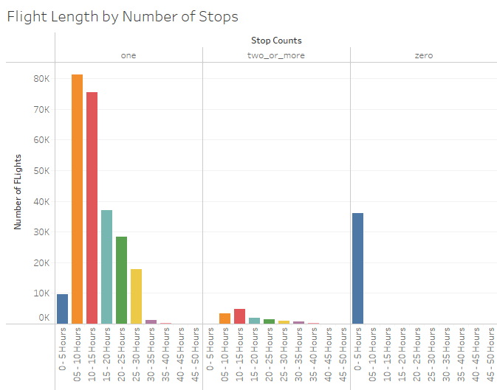
Flight Duration: impacted by stops?
Direct, non-refuelling flights were limited to under 5 hours.
One stop flights could range anywhere from 2 -40 hours.
Two or more stop flights were not skewed towards higher durations.
Notes:
Flights were only direct if they were under 5 hours.
There was not** a high correlation between the number of stops & the flight length or distance traveled (next slide).
Flights with 2 or more stops had a similar duration distribution to 1 stop flights.
30+ hourlong rides are equally as likely to happen with one stop as with 2 or more.
I expected 2+ stops to be skewed towards the longest of the flights.
If a flight had 2+ stops, it wasn’t necessarily because it was disproportionately longer or further than other flights.

